Slide 1
RIVER DRONE training
Get familiarized with the future.

Slide 2
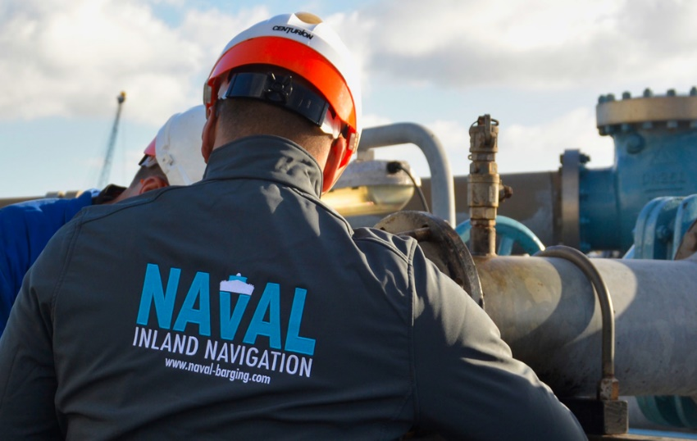
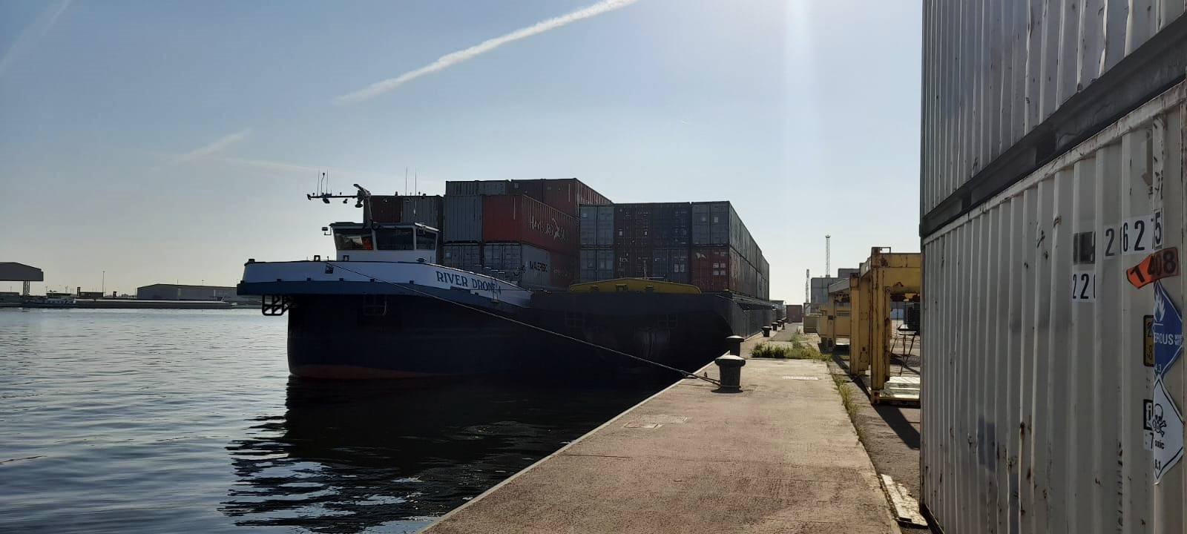
IMPORTANT CONTACTS
TECHNICAL
HUMAN RECOURCES
NAVAL BARGING
Edwin Boer
+32 495 563 563 / +31 6 15 94 98 66
Melvin Hamar de la Brethonière
+31 6 11 03 28 06
GLYNIS BUSCHGENS
+352 621 785 183
Annika Verheyen
+352 621 623 754
Fernanda van opstal
+32 478 45 50 53
Filip Lamoral
+32 469 43 81 60

Slide 3
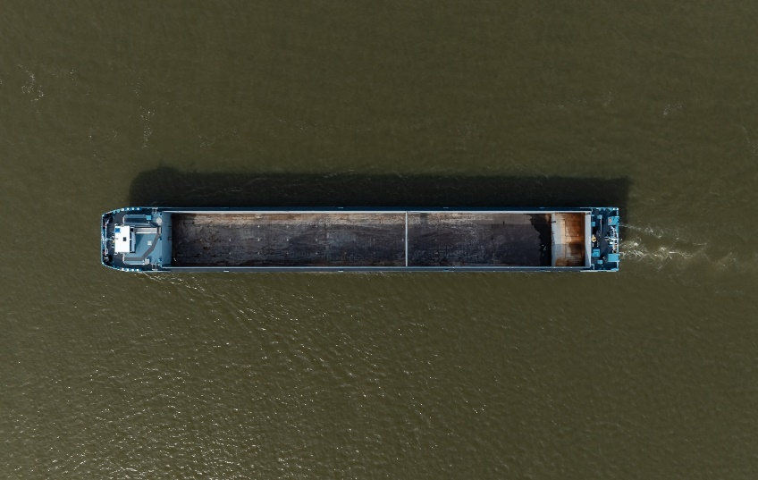
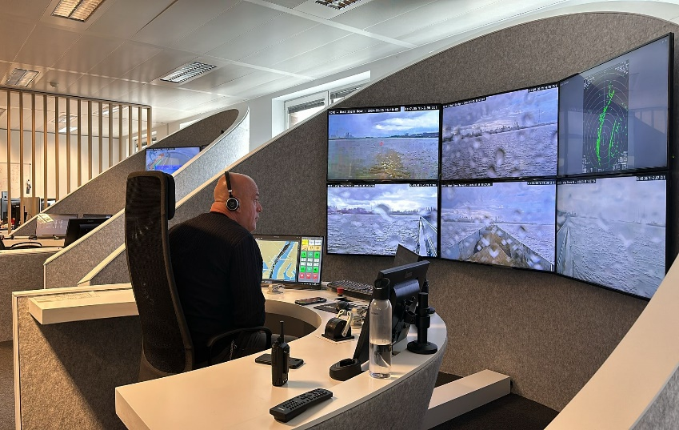
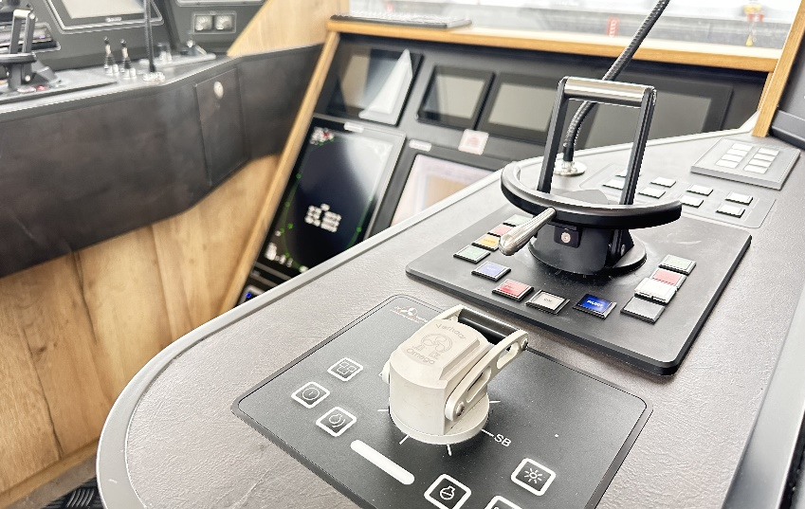
WHAT IS A RIVER DRONE?
Dry - cargo vessel
High-tech vessel
Semi-autonomous vessel
Up to 3850T capacity
Possibility to remote navigation
Hybrid ship with great maneuverability

Slide 4
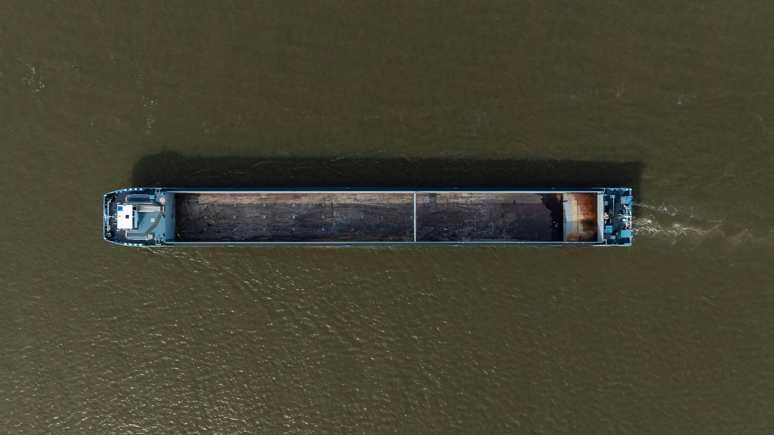
DRY CARGO SHIP
A River Drone is a ship that can handle all types of dry cargo.
What are the specifications of this vessels?
Total capacity of 3850T.
Length: 106m
Width: 11,75m
Minimum height: 6,80m (empty)
Max draught: 4,11m
Total weight empty: 910T.

Slide 5
REMOTE CONTROL NAVIGATION
These vessels have the possibility to be controlled from the shore.
This technology is giving lots of advantages for the captain and shipping company.
What are the important things:
Possibility to sail for 24h, even with crew reduction.
Remote Control by Seafar in Antwerp.
Time to handle administration or rest during sailing.
On certain trajectories the shore based captain can be written in the sailing time book.
(Albert Channel)

Slide 6
HIGH – END TECHNOLOGY
Every River Drone is identical to its sisters. The vessels are equipped with the lastest technology which makes them a one of a kind.
An example of the equipment on board:
2x Equadrive thruster (110° PS & 110° SB)
2x Bowthruster steering grid in the front.
2x spudpoles (1x 9.1 meter front, 1x 8.2 meter back)
A complete electronic alarm & monitoring system.
16 camera´s in and around the ship.
2x radar (front & back).
Seafar remote control system.

Slide 7
Equipment on board
Equadrives
Bowthrusters
Alarm & Monitoring PLC
Spud Poles
Seafar Remote Control
Cargo area bigger then normal
In combination of the equadrives and bowthruster, the ships are highly manouvreble and easy to operate.
With the 2x 550 Kw (total appr. 1500hp) Equadrives and 2x 450 Kw bowthruster (total appr. 1230hp) makes that the whole ship + cargo can navigate safely.
Due the complete electronic PLC system all the engines, equipment and status of the vessel can be checked in real-time. Also in case of fire, flooding or other issues the captain will be informed due to alarms around the ship.
Because of the spudpoles the ship has the ability to lay on an anchor place without any problem. Also during loading and unloading the poles can be used.
The Seafer Remote Control function is a new and futuristic tool. This tool is giving the captain a new experience and is providing the advantage of more rest. Next to that it is possible to navigate for 24h even with a reduced crew. (note... This is not yet possible on all waters)
The cargo hold is exceptional big compared to other vessels with the same or longer length. The cargo hold can transport 3850T of goods and is an extreme advantage for these vessels towards the customers.

Slide 8
ENGINE ROOMS aft
The engineroom is divided by 3 separate rooms. Every main engine has is own room as well as the propulsion.
The 2 main engine rooms are electrical connected to eachother with a automatic breaker. In case of fire of flooding in on of the enginerooms the breaker will open which causes a seperate electrical installation.
Both enginerooms have watertight doors which HAS TO BE CLOSED during navigation.

Slide 9
ENGINE ROOM front
The front engineroom is technically not an engineroom because there are no cobustion engines. Only the bowthrusters are located in this room which are provided by power from the back.
Because this is no engine room there is also no emergeny exit provided.
For the rest you can find electrical cabinets that are providing power to the accomodation and to the wheelhouse.

Slide 10
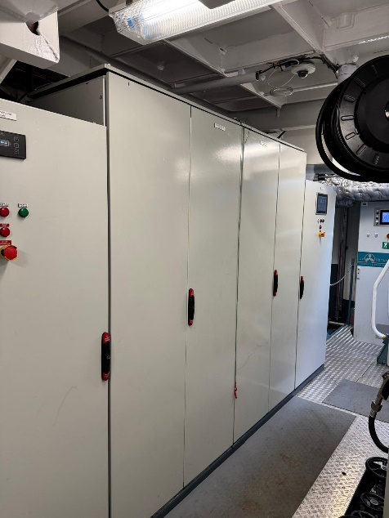
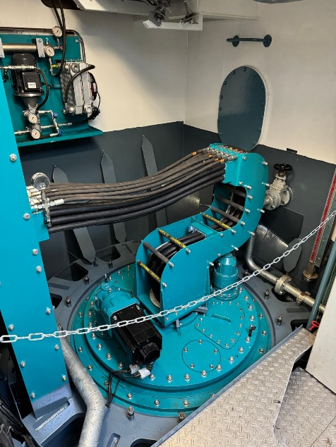
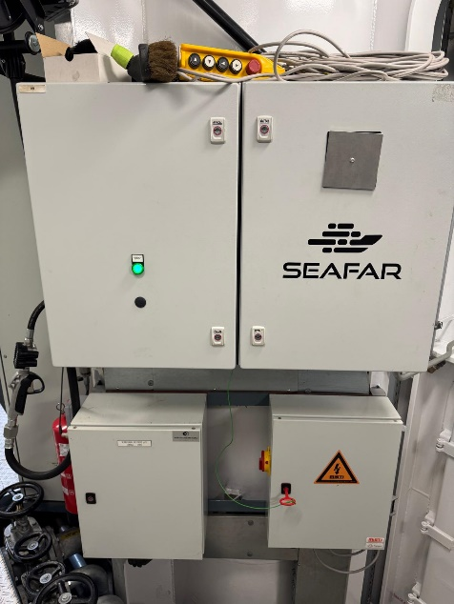
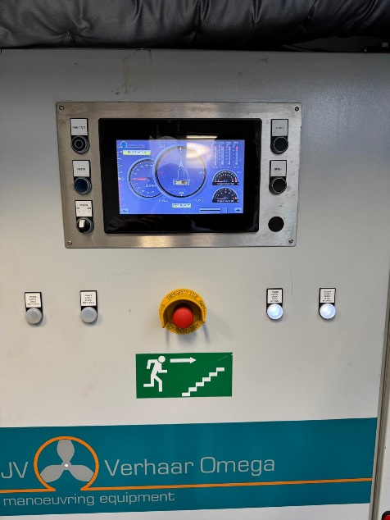
Engine rooms AFT
The aft. engine room is the heart of the complete vessel. All the electricity is distributed through here and gives power to all the propulsion drives.
The engine rooms are divided in 3 seperate rooms:
Propulsion Room - PS Engine Room - SB Engine Room
Electrical Cabinets Propulsion Room
Equadrive Propulsion Room
Seafar / Misti Propulsion Room
Local controls
Propulsion Room

Slide 11
Electrical cabinets – propulsion room
These cabinets are fitted with all the components that are distributing the 480Vac to the equadrives. When you have an alarm like below explained in the wheelhouse on your equadrives displays then you can find the solutions in the PS and SB side cabinets.
Vacon drive alarm: Coolwater pump is not running.
Equadrive not following: Fuse 052 In cabinet 1 or 2. (depending on which side alarm)
480Vac alarm: Fuse in cabinet 1 or 2 (depending on what side alarm)
Cannot switch on | Set throttle lever in zero Position: The throttle in the wheelhouse is not on zero position.
Servo motor 1 | not connected to drive: Fuse in cabinet 1 or 2 (Depending on which side alarm)
NO Communication with PLC: Turn off fuse 22F7, 24F2, 24F5 in the sb or pS verhaar cabinet. (depending on which side alarm)

Slide 12
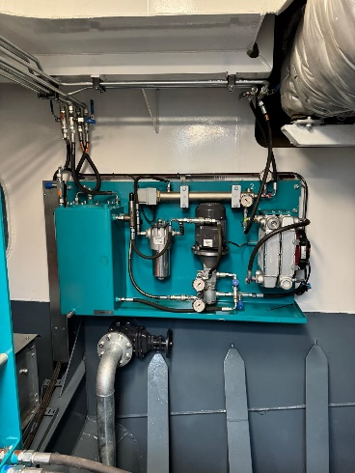
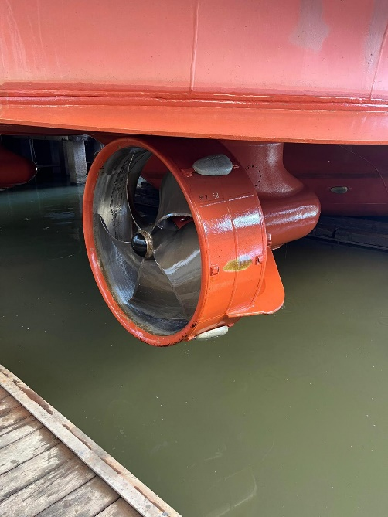
The equadrive is the main propulsion of a River drone. This system is a thruster under the back of the ship. The equadrive is able to steer 110° portside & 110° starboard side. Because they are turning 110° both sides the system has a forward and backward function.
Equadrive installation
Equadrive inside unit
The cooling of the equadrive is established on 3 ways.
1st: The e-motor is located under the water
2nd: The system is cooled by oil
3rd: Every oil line additionally cooled by coolwater.
The oil pumps are located behind the equadrive in the propulsion room. These pumps need to run in order to guarantee a cool system.
Equadrive outside unit

Slide 13
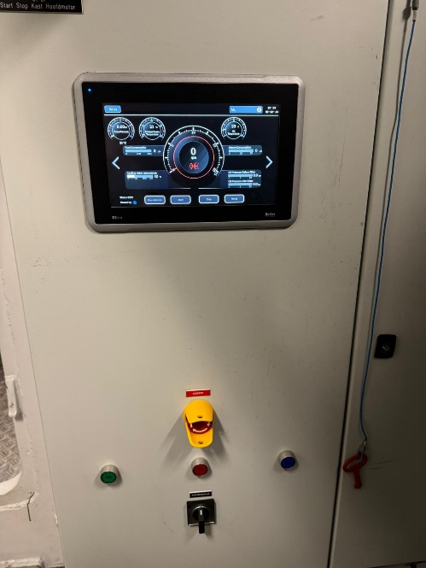
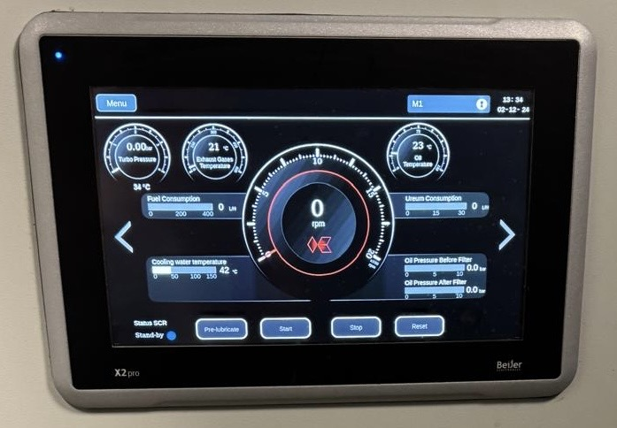
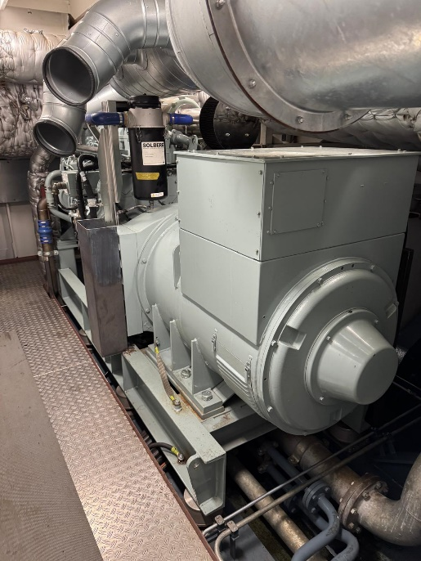
Main Engine rooms
The engine rooms are the heart of the vessel. In each engine room (PS & SB) we can find 2 Mitsubishi gensets which are providing 550KW each.
SCHERM KOEDOOD
KAST KOEDOOD
Just like all other systems, the engines can also have alarms and malfunctions. On the next slide are the solutions for the most common alarms.
All alarms are displayed on the koedood display in the wheelhouse as well as the enginerooms.
The Mitsubishi Stage v engine.

Slide 14
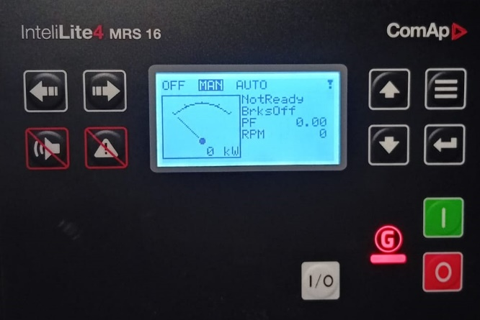
Main Engine rooms
In each engine room (PS & SB) there is a smaller generator located. In the PS engine room a 60KVa and in SB engine room a 30kva.
Control panel 30 & 60 KVA
30 KVA (Air Cooling)
The 60kva generator is a backup system for the microgrid. The microgrid is providing the boardnet while sailing.
If the Microgrid is failing, the 60kva will take over automatically.
60 Kva - watercooling

Slide 15
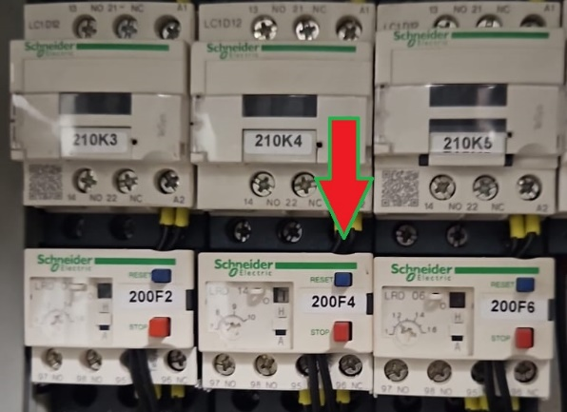
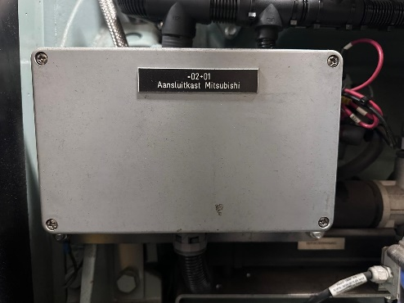
KOEDOOD – Alarm - solutions
LT Pressure LOW
SCR reduction not reached
Intake temperature High
1st Fuse F052 in main engine room off.
Request 75% power for 30 min.
Change air filter in front of Turbo.
2nd Fuse 200F4 reset by blue button.
Engine doesn´t start after 3 times
The fuse of the start motor is off. Turn of the fuse and try again.

Slide 16
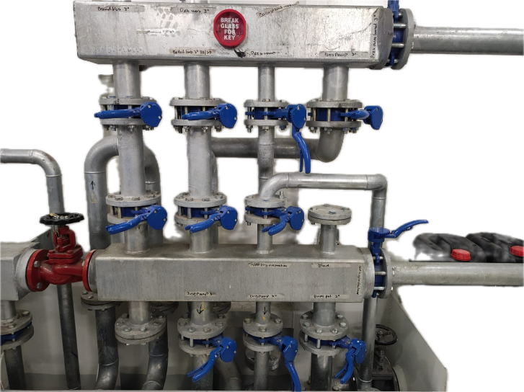
Ballast system
The vessel has the possibility to take ballast in the front and back of the ship. In the back it is nessacerry to take ballast in order to put the thrusters under water by empty ship.
Press – Suction block front
Combination 1: Deckwash
Combination 2: Ballast - in
Combination 3: Ballast – out
Combination 4: emergency emtpy greywater
With ballasting the vessel we only use the 2 U-tanks. No other tank will be used for ballast.
Exceptional with very bad weather the front can be filled with water. Note: after using the pumps close all valves

Slide 17
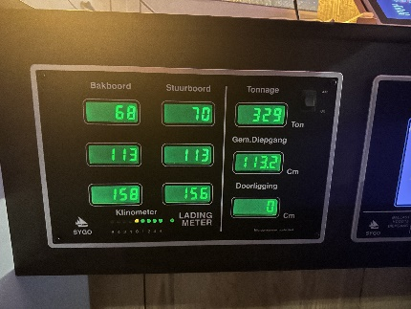
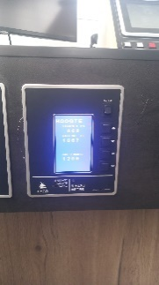
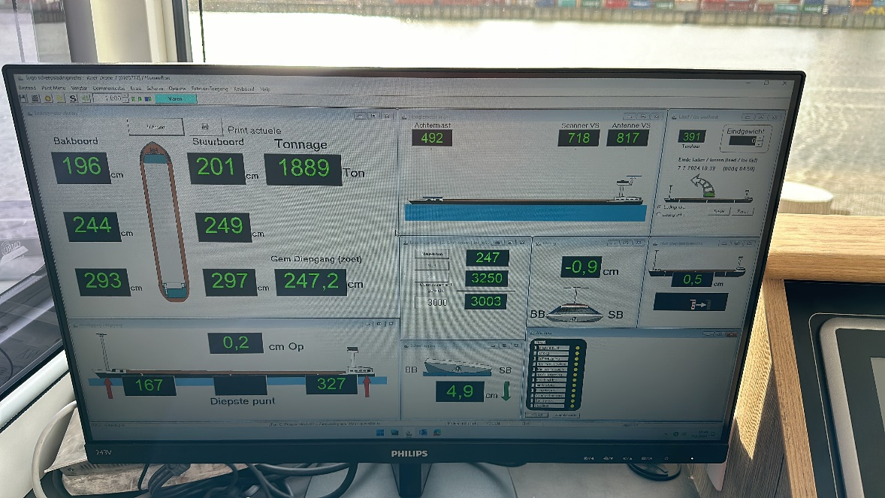
SYGO
On the boardcomputer we have a draught and tonnage software. In this software you can find the actual information of the vessel.
Draught & tonnage
Height

Slide 18
SYGO - functions
Draught in centimeters
Total tonnage
Average draught
Hogging and sagging in centimeters
Tilting
Torsion
Height mast back
Height mast front
Height wheelhouse
Tonnage per hour
loading ticket
1
10
2
7
8
9
3
11
6
4
5
Total tonnage: this is the total tonnage including the ballast.
Average Draught: This is the average draught calculated by the 6 sensors.
Hogging and sagging: while loading the ship is moving all directions. In order for a safe voyage don’t go over 8cm.
Tilting: the amount in centimeters that the ship is tilting to sb or ps.
Torsion: the amount in centimeters that the ship is torsing. Don’t go over 6cm.
Heights: the height of the masts and wheelhouse calculated from the water.
Loading ticket: Here you can start a new ticket. When ballast is out press start. The system will calculate the tonnage excl. ballast. So this is the real loading tonnage.

Slide 19
Start-up procedure
FOLLOW THE BELOW PROCEDURE:
Turn on the both engines on PS and SB.
Wait until all the lines in the PMS display are green.
Turn on the Equadrive control panels.
Turn on the Bowthruster control panels.
Check if there alarms active in the Werkina, Verhaar and Koedood displays.
If there is an alarm active, solve it before leaving. If your not sure about the alarm call with the TD department.
When everything is green and OK, you can start the voyage.
In order to avoid unnecessary alarms during the start up of the ship. There is a procedure that has to be followed.

Slide 20
shutdown procedure
FOLLOW THE BELOW PROCEDURE:
Turn of the Equadrive control panels.
Turn of the Bow Thruster panels.
Turn of both the engines by pressing the stop button under each engine in the PMS display.
Wait until the breakers of the main engines in the PMS display are RED.
The 60Kva generator will start up automatically to provide the boardnet.
The main engines are now in cooling down modus and will turn of around 200 degrees exhaust temperature.
In order to avoid unnecessary alarms during the shutdown of the ship. There is a procedure that has to be followed.

Slide 21
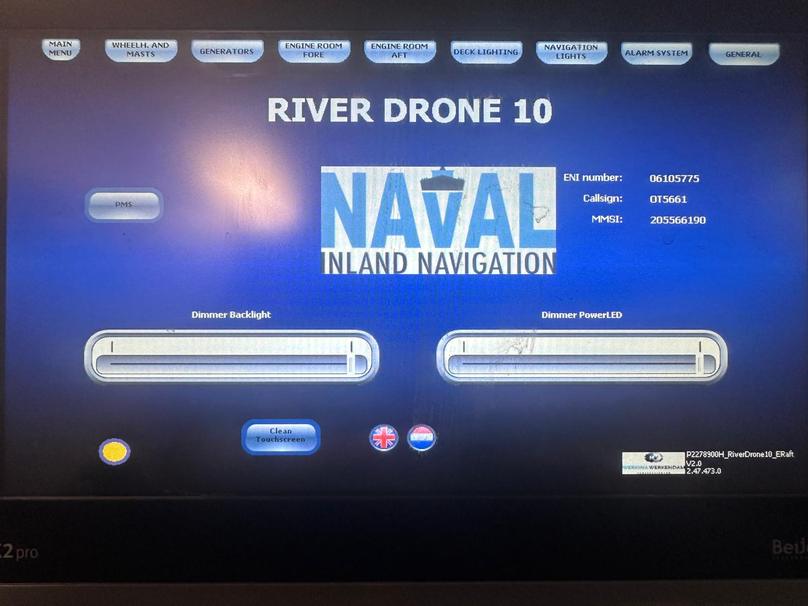
WERKINA automatisation display
The Werkina display is providing you the possibility to control the complete vessel in one display. This system is created special for the River Drone and gives you all the information which is needed.
In this topic we will discuss all the functions that is available.
In the wheelhouse there are 3 Werkina displays. In the Propulsion Room there is one.

Slide 22
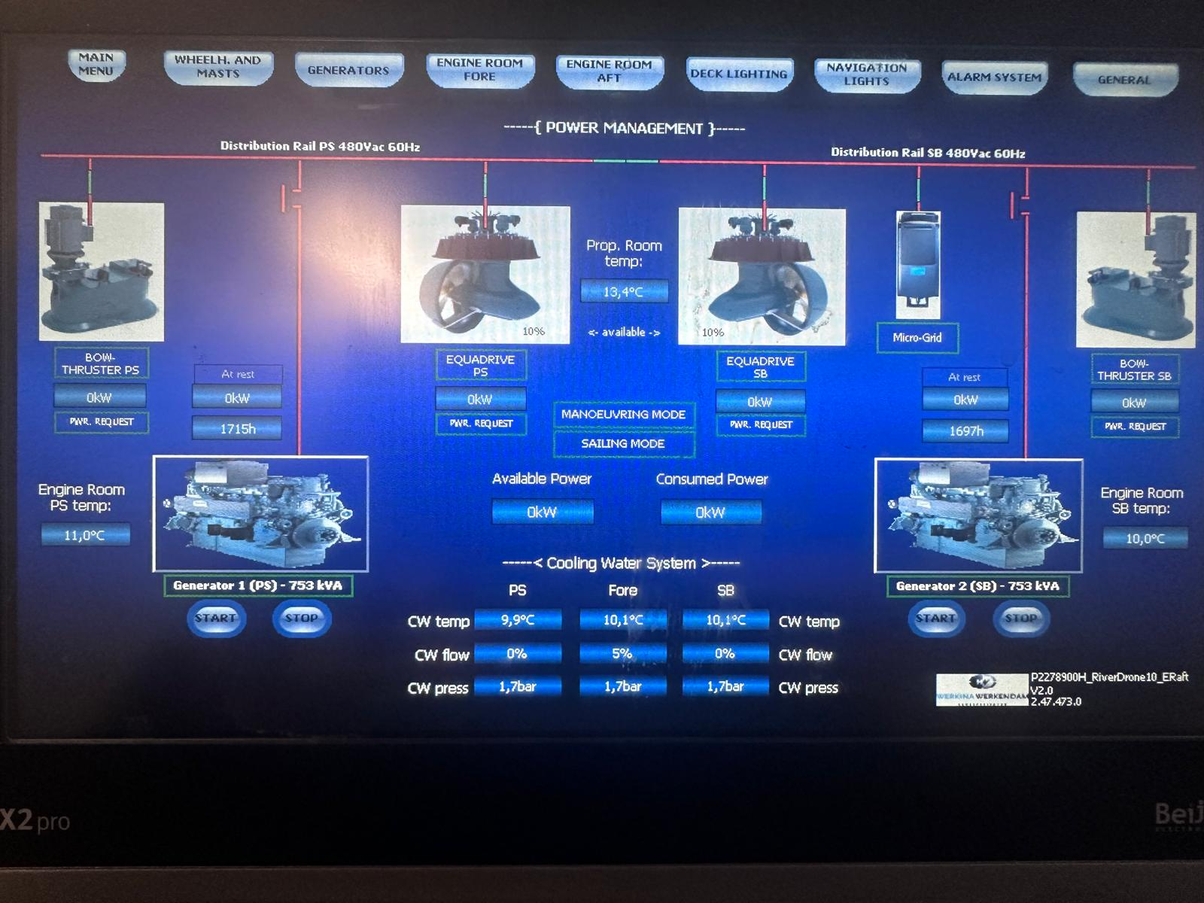
WERKINA automatisation display
Left Side:
Bowthruster PS: When the control panel of the bowthruster is enabled in the wheelhouse, there is a power request. If the engines are not running, the system will start them.
Generator 1 PS: The start button under the engine is used to turn on the main engine. On the moment that the motor is running 1800rpm the red line will turn green. This means that the generator is providing 480 Vac. The breaker will close and is providing power on the complete board.
Equadrive PS: When the control panel of the Equadrive is enabled in the wheelhouse, there is a power request. If the engines are not running, the system will start them.
Right Side:
Bowthruster SB: When the control panel of the bowthruster is enabled in the wheelhouse, there is a power request. If the engines are not running, the system will start them.
Generator 2 SB: The start button under the engine is used to turn on the main engine. On the moment that the motor is running 1800rpm the red line will turn green. This means that the generator is providing 480 Vac. The breaker will close and is providing power on the complete board.
Equadrive SB: When the control panel of the Equadrive is enabled in the wheelhouse, there is a power request. If the engines are not running, the system will start them.
Microgrid: The Microgrid is providing the boardnet power while sailing. This system is therefore only for providing 230Vac and has nothing to do with the propulsion system of the vessel. If the Microgrid is failing, the 60Kva will automatically take over.
Cooling Water System:
CW Temp: This is indicating the temperature of the coolwater.
CW Flow: On the moment that the Equadrive panels are turned on the coolwater pump will start to run. Here you should get a % above the 60.
CW Press: The pressure on the coolwater system should always be above 2,0 Bar when the pump is running.

Slide 23
WERKINA automatisation display
This is the “Main Menu” display. In this display we can find the following functions:
PMS: This is the Power Management System.
Dimming Backlight & Powerled. Here you can dim the display and blue led on the edge of the display.
Language selection.
Practical info about the vessel. ENI, Call Sign, MMSI.

Slide 24
WERKINA automatisation display
This is the “Wheelhouse and Mast” display. In this display we can find the following functions:
PMS: This is the Power Management System.
Dimming Backlight & Powerled. Here you can dim the display and blue led on the edge of the display.
Language selection.
Practical info about the vessel. ENI, Call Sign, MMSI.

Slide 25
WERKINA automatisation display
This is the “Generators” display. In this display we can find the following functions:
PMS: This is the Power Management System.
Dimming Backlight & Powerled. Here you can dim the display and blue led on the edge of the display.
Language selection.
Practical info about the vessel. ENI, Call Sign, MMSI.

Slide 26
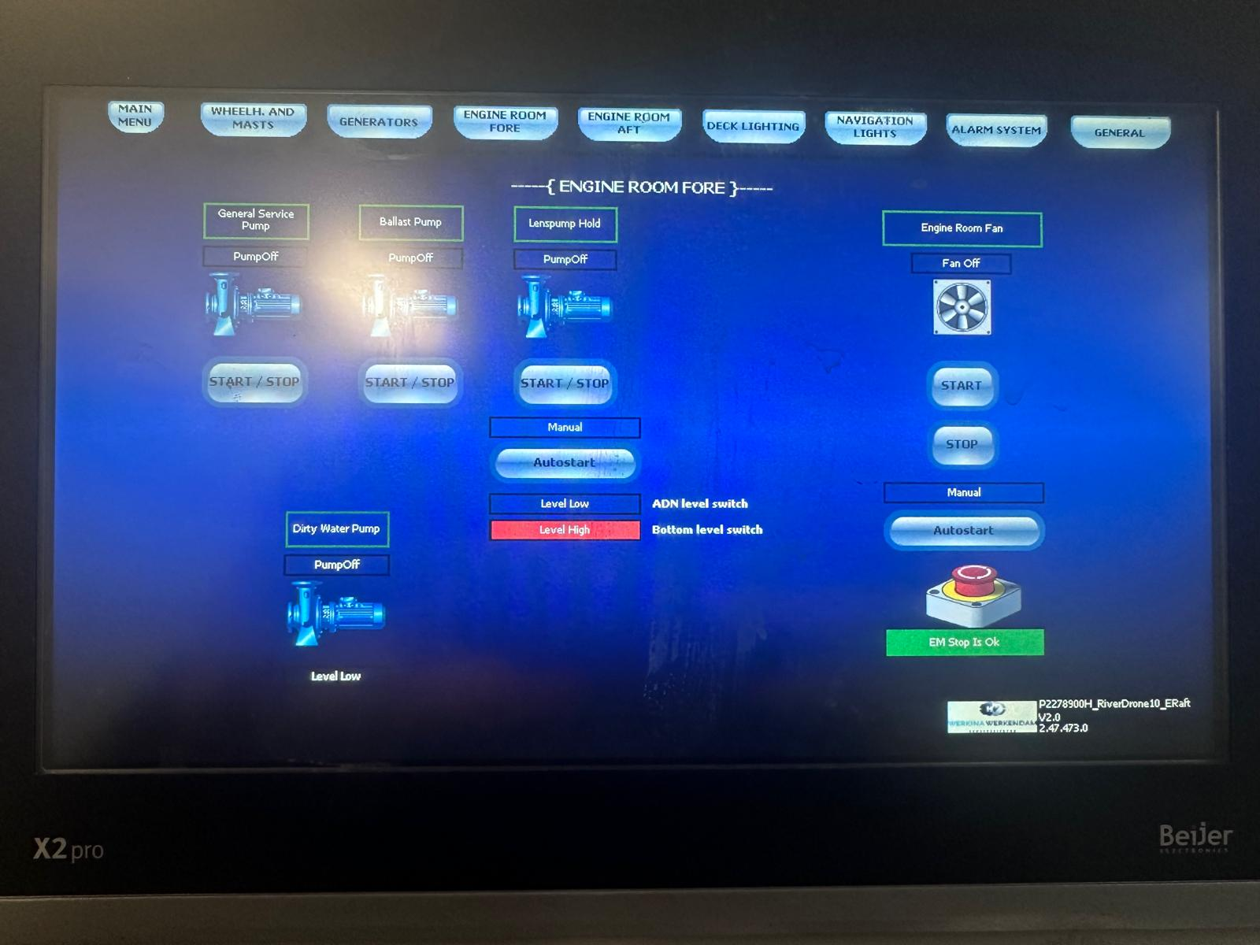
WERKINA automatisation display
This is the “Engine Room Fore” display. In this display we can find the following functions:
General Service Pump. Here you can start the deckwash pump.
Ballast Pump: Here you can start the ballast pump.
Lenspump Hold: Here you can start the cargo pump manually. When Autostart is active the pump will start automatically.
Engine Room Fan: Here the ventilator in the front engine room can be started.
EM-Stop: This is an indication of the emergency stop in the front of the ship.
Dirty Water Pump This is an indication of the status of the Dirty Water Pump.

Slide 27
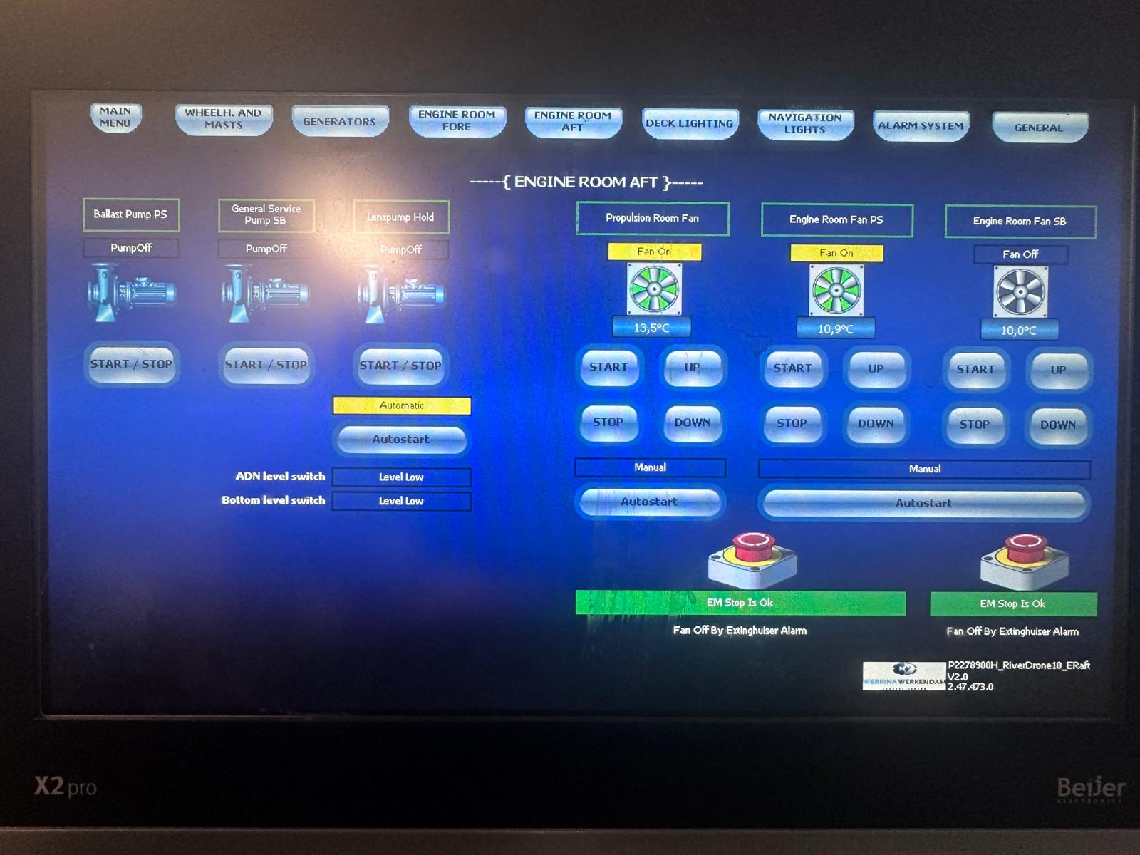
WERKINA automatisation display
This is the “Engine Room Aft” display. In this display we can find the following functions:
Ballast Pump: Turn on/off the Ballast pump.
General Service Pump: Turn on/off the Deckwash pump
Lenspump Hold: Here you can start the cargo pump manually. When Autostart is active the pump will start automatically.
Engine Room Fan: Here the ventilator in the front engine room can be started. Make sure that the autostart is selected when starting the engines.
EM-Stop: This is an indication of the emergency stop in the front of the ship.

Slide 28
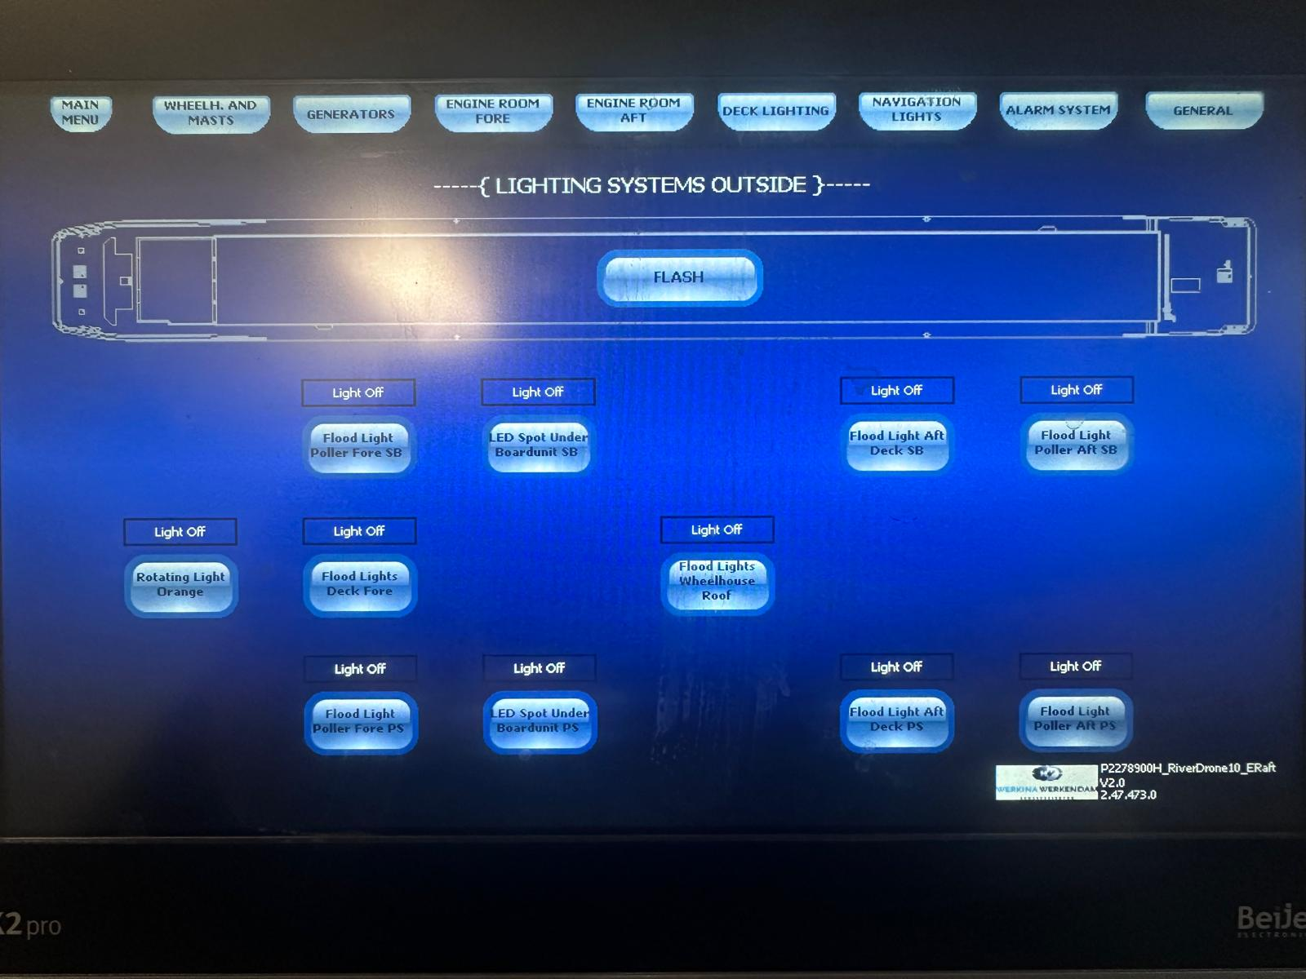
WERKINA automatisation display
This is the “Deck Lighting” display. In this display we can find the following functions:
Flash: By pressing this button all external lights on board will turn on and off.
Various Lights: Turn on/off the selected light.

Slide 29
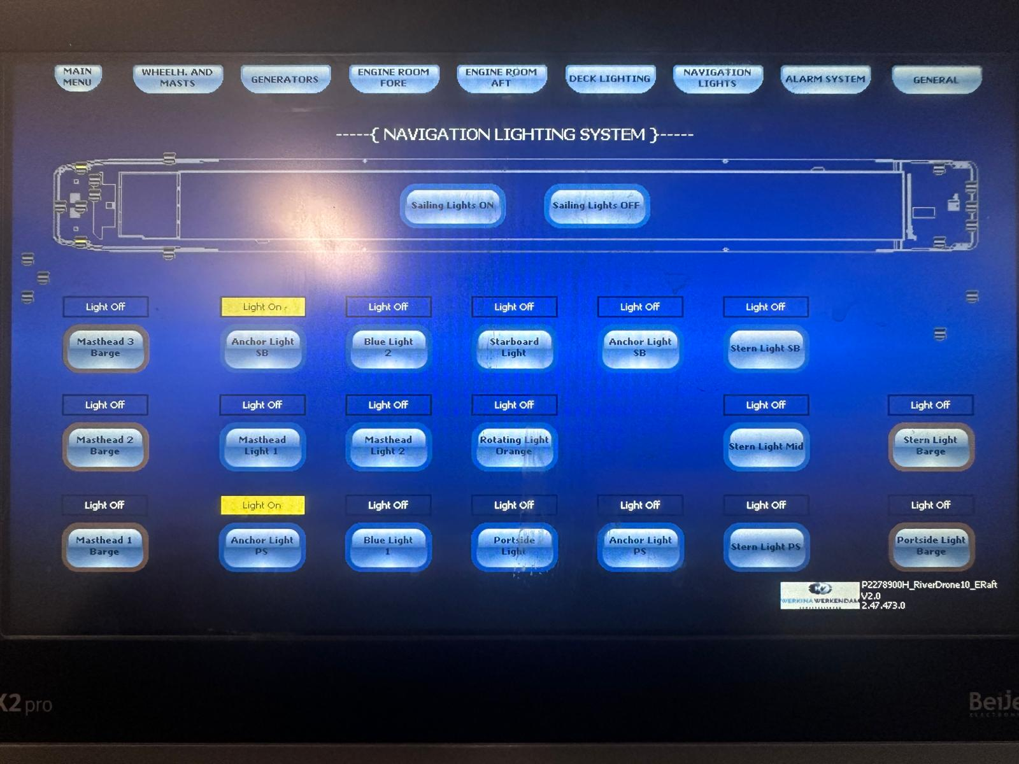
WERKINA automatisation display
This is the “Deck Lighting” display. In this display we can find the following functions:
Sailing Lights ON/OFF: By pressing this button all navigation lights needes will turn on/off directly.
Various Lights: Turn on/off the selected light.

Slide 30
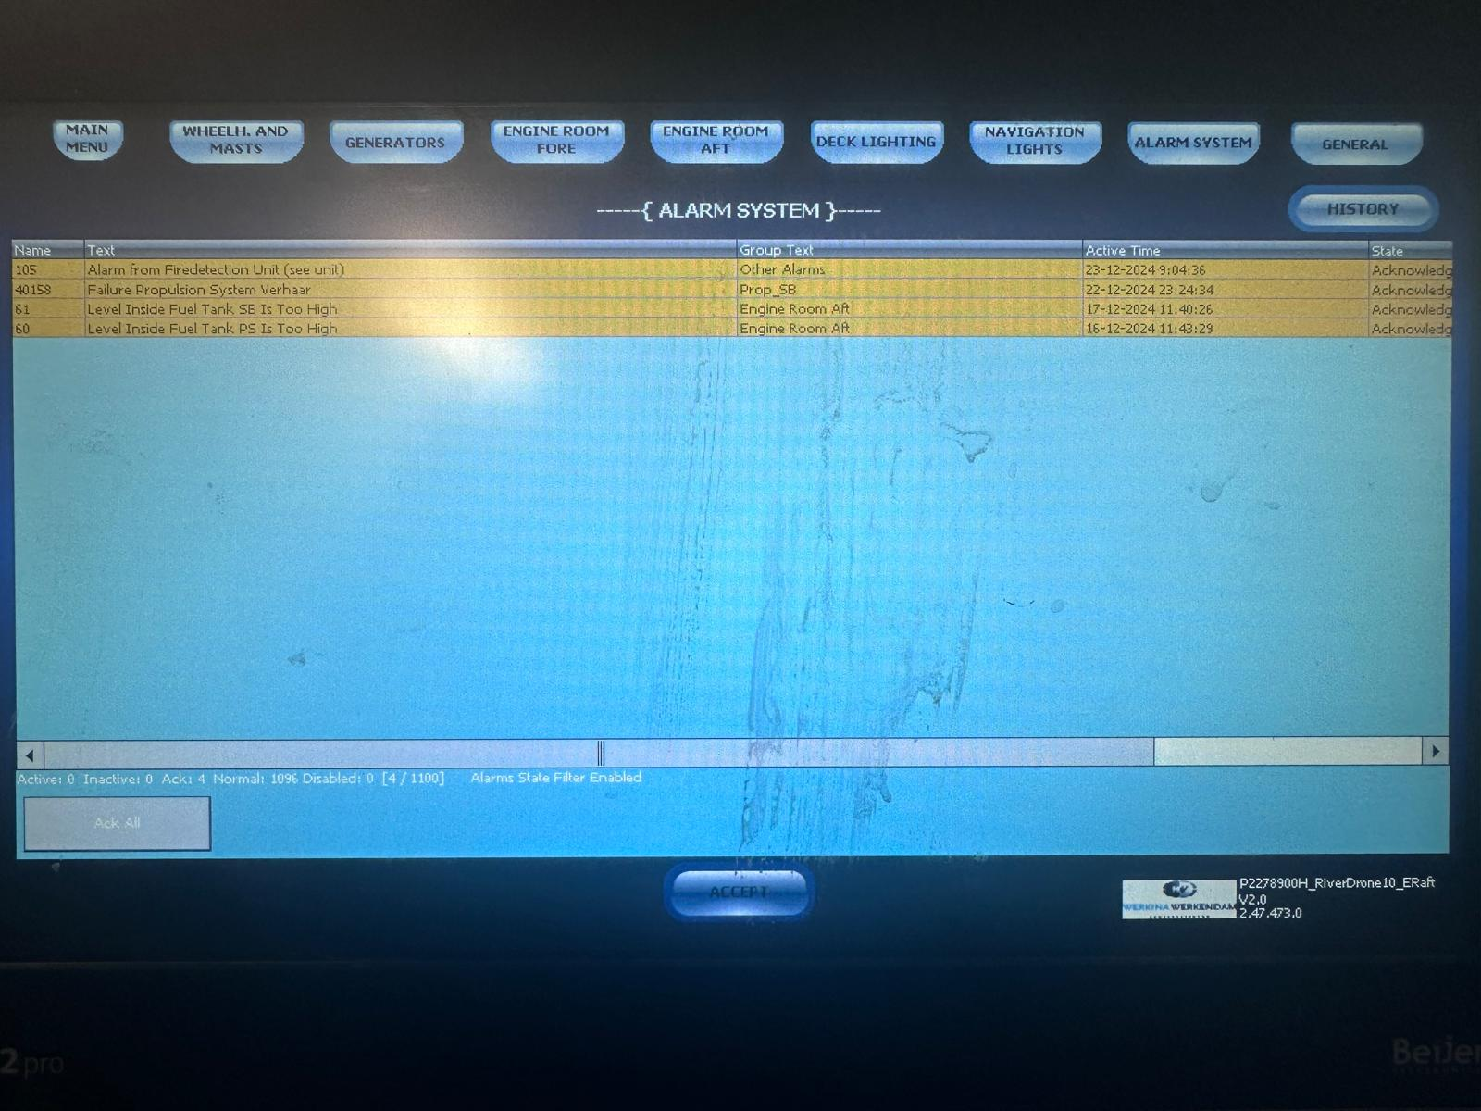
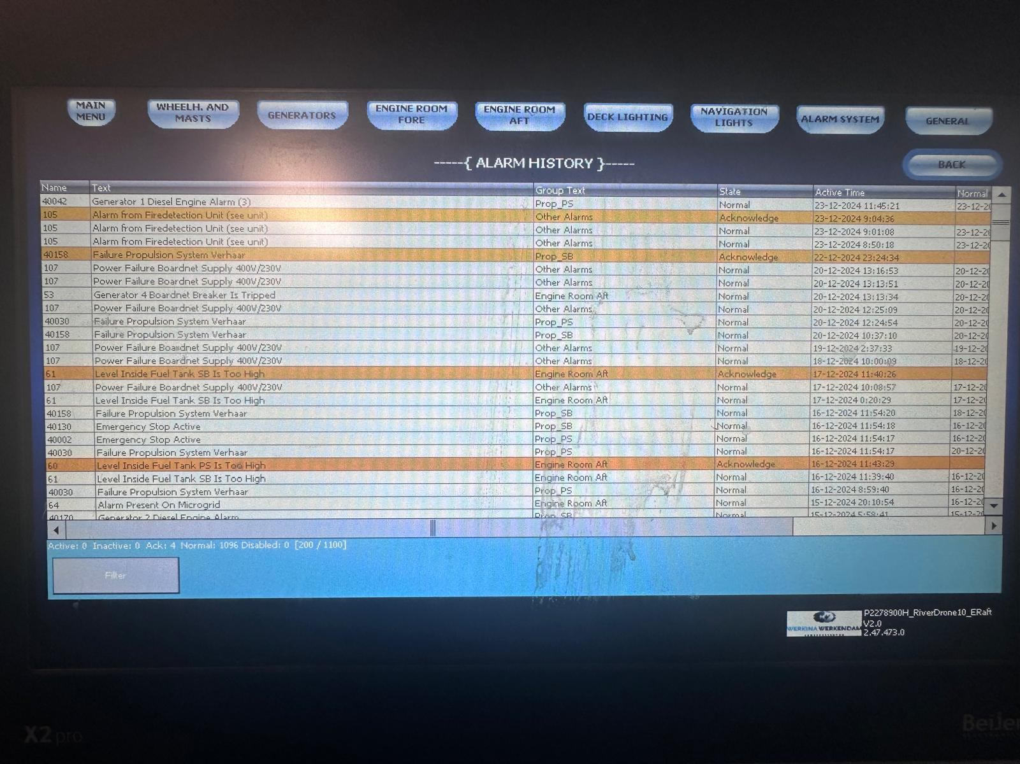
WERKINA automatisation display
This is the “Alarm System” display. In this display we can find the following functions:
Picture 1: This are the actual alarms. Red is new, yellow is accepted but active, gone is accepted and inactive.
Picture 2: Here you can view the complete alarm history for max. 2 months back in time.

Slide 31
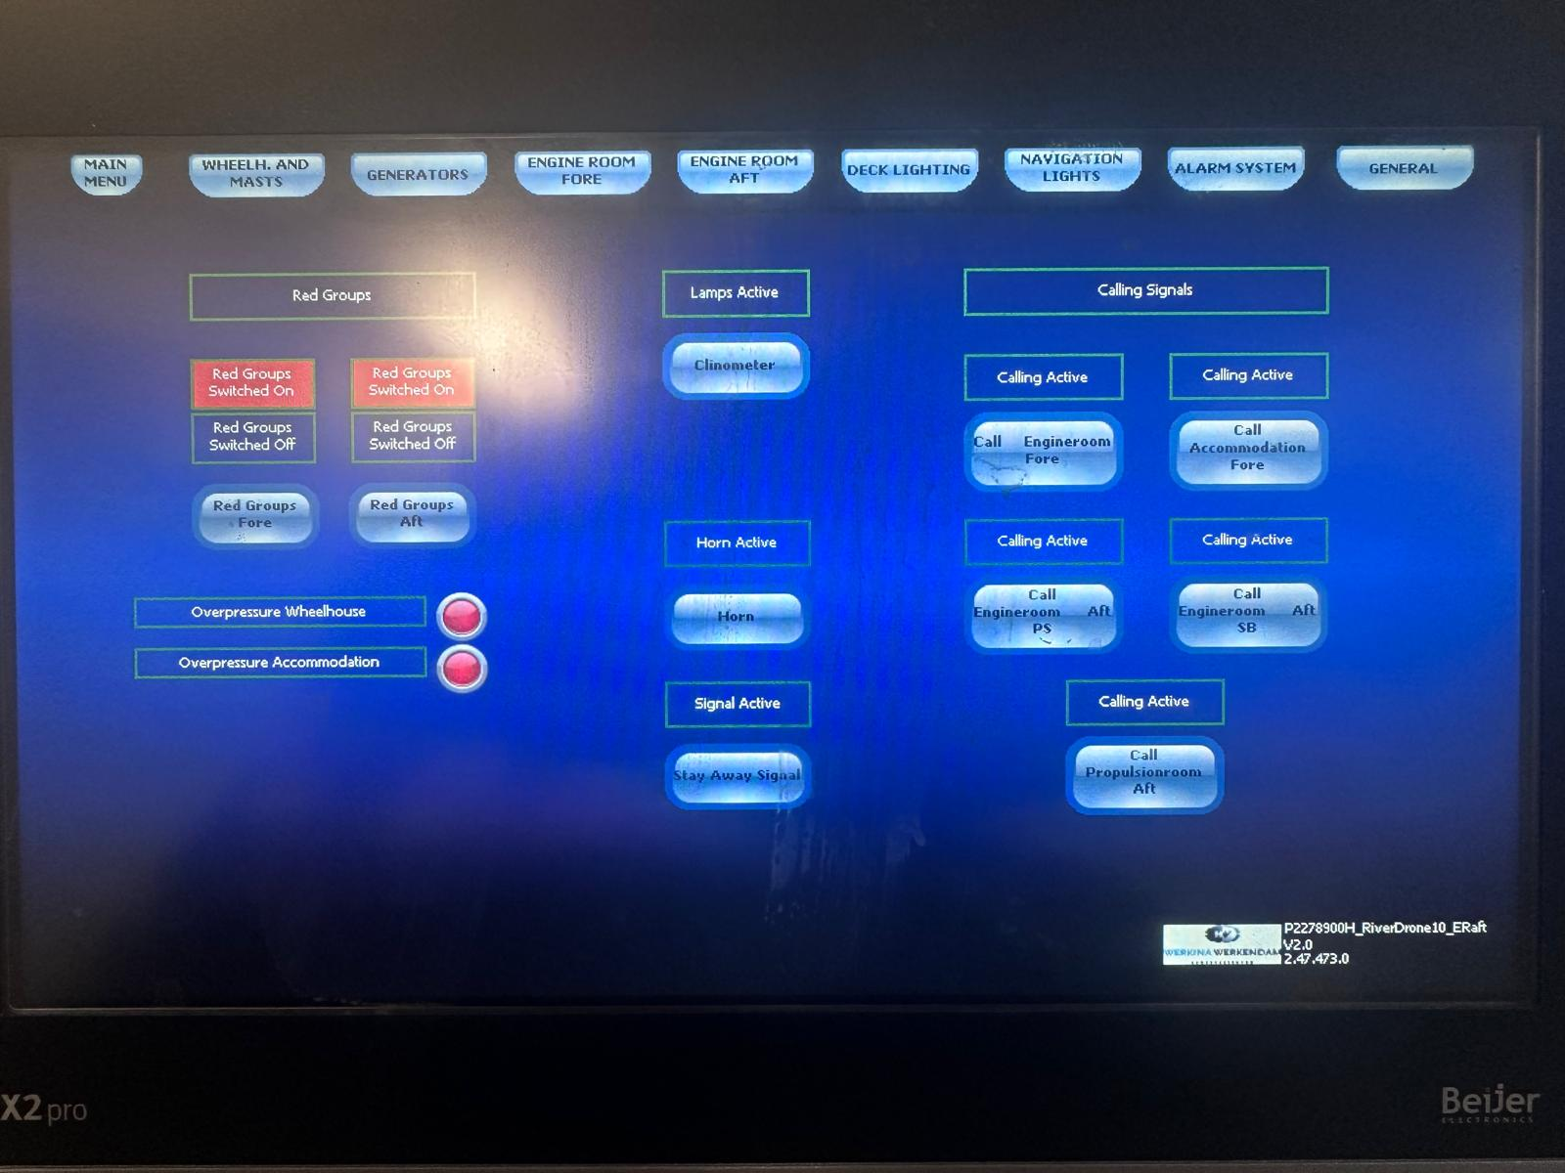
WERKINA automatisation display
This is the “General” display. In this display we can find the following functions:
Red Groups: This is indicating the status of the Red Groups in the front and backship.
Red Groups Fore: With this button the red groups can be (de)activated.
Red Groups Aft: With this button the red groups can be (de)activated.
Cinometer: Turn on/off the clino lights in the aft mast.
Horn: By pushing the horn turns on, at release of the button the horn turns off.
Stay Away Signal: By activating the Stay Away horn signal will be turned on.
Calling Signals: Here you can activate the general alarm in sections.

Slide 32
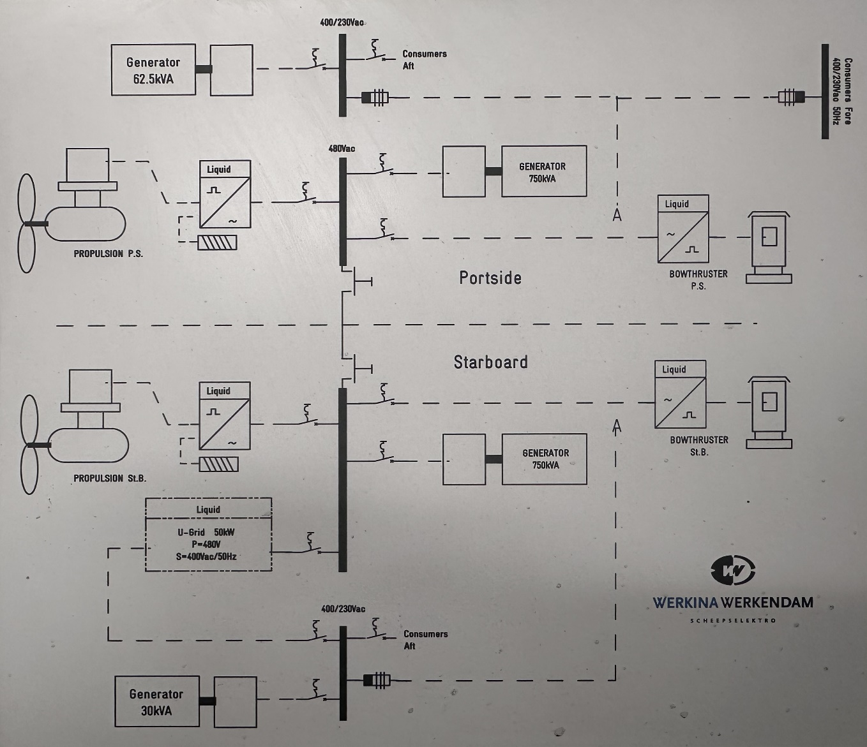
WERKINA Propulsion setup
This image is showing the complete setup of the Power Management System which is made for the entire propulsion system.

Slide 33
WERKINA – Alarm - solutions
Generator 1 Diesel Engine Alarm
Go to PS Koedood display in Wheelhouse
Alarm from Firedetection unit
Go to firedetection unit on the side of the couch in the wheelhouse
Failure Propulsion Verhaar
Go to Verhaar display of the Equadrive or Bow Thrusters
Power Failure Boardnet Supply
Microgrid, 30Kva or 60Kva generator is off
Generator breaker tripped
Breaker in aft engineroom needs to be pumped
Generator Synchronizer Comap Failure
Component in the generator defect. Report to TD
Modbus Communication Failed
Report to TD
Isolation fault 24Vdc installation
Earth fault in the ship. This can be found by switching off all fuses and turn on one by one.

Slide 34
WERKINA – Alarm - solutions
Power Failure Gasdetection
Turn on 230Vac converter in front engine room
Bilge level High Engine Room
Check on water in the bilges. If needed pump out with lenspump
Dirty water tank level high
Empty the dirty water tank
No drinking water from tap / hydrophore doesnt turn on
Dirty water tank full. Empty with pump.
Propulsion Regulator coolwater low
Coolwater pump is not running, check fuse in propulsion room
Propulsion regulator coolwater pressure low
Check the pressure in the PMS screen. If needed fill up the coolwater on the watercooler
Door wheelhouse lift open
Close the door in engineroom on kolom, make sure plates are in front of it.
Isolation fault 24Vcd installation
Earth fault in the ship. This can be found by switching off all fuses and turn on one by one.

Slide 35
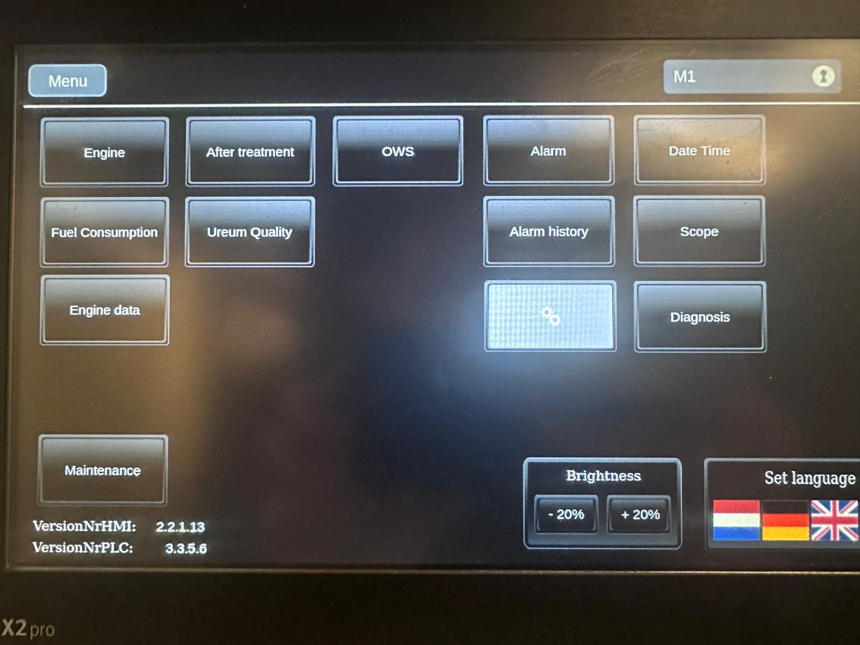
KOEDOOD engine controls
This is the “Menu” display. In this display we can find the following functions:

Slide 36
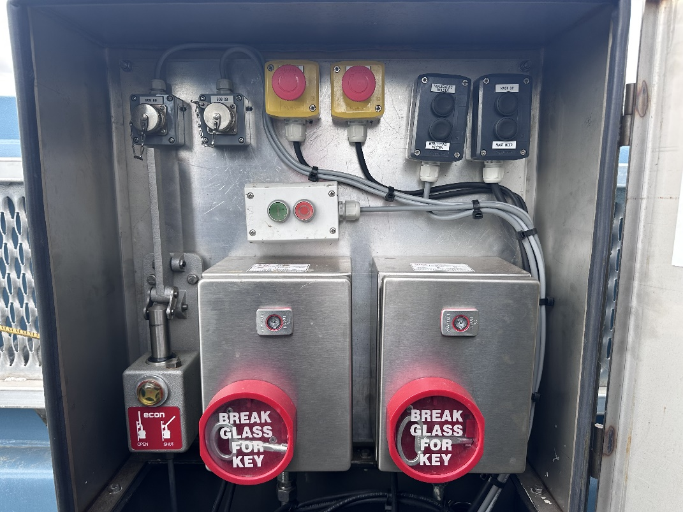
AFT deck cabinet hydraulic – bunker - emergency
3
4
5
6
1
2
7
8
9
10
1. PS BOB: Bunker Overflow Protection for PS gasoil tank 6. Controls for putting mast up / down.
2. SB BOB: Bunker Overflow Protection for SB gasoil tank 7. Start/Stop button for hydraulic pump winches AFT.
3. Emergency PS 8. Emergency valve to cut down the gasoil flow to engines.
4. Emergency SB 9. Cabinet + key to activate the Novec1230 extinquisher PS.
5. Controls for Decklights aft 10. Cabinet + key to activate the Novec1230 extinquisher SB.

Slide 37
Natural Resources
Water
Name the major rivers and bodies of water.
Minerals
Name and describe a few different kinds of minerals.
List
List

Slide 38
Natural Resources, continued
Plant Life
Name and describe some of the trees and wildflowers.
Animal Life
Name and describe some of the wild animals.
List
List

Slide 39
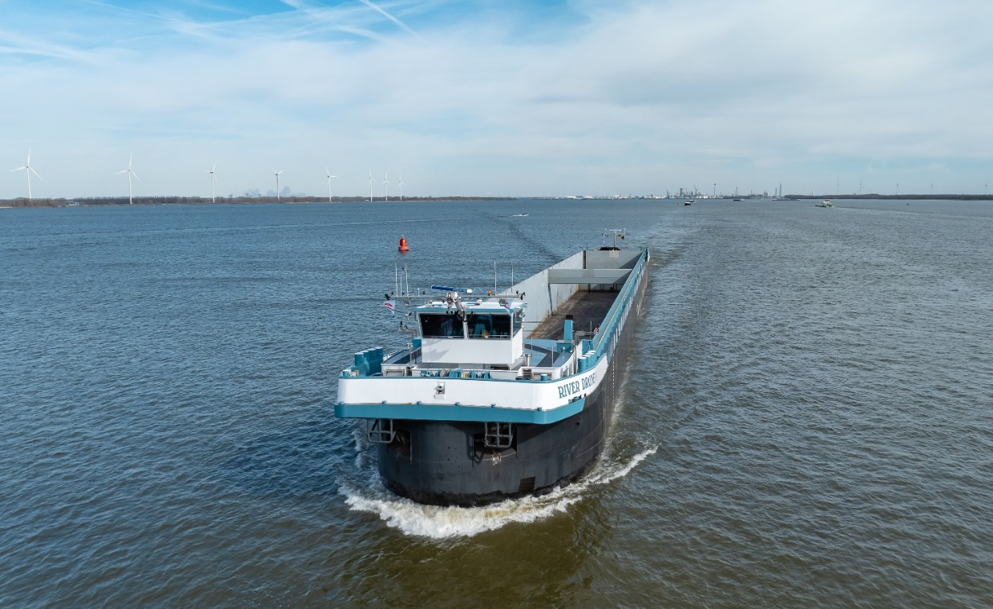
Practical training
Complete start-up of all engines.
Start-up all Thruster and Bowthrusters.
What alarms can come + solutions.
Let-go lines and sail away.
Navigating and Manouvring.
Use of VHF Radio at locks and sectors.
What to do in case of emergency. (captain sick)
What to do in case of emergency. (crashstop)
What to do in case of emergency. (Seafar)
Moor the ship and tie up the lines.
Shutdown of Thruster and Bowthrusters
Shutdown of Main Engines.
Tour around the engine rooms back and front.

Slide 40
PRE-check startup
Oil levels Mitsubishi Engines
Coolwater levels Engines
Oil levels Winches
Oil Level Wheelhouse
Oil Levels Verhaar
Pressure Coolwater Propulsion
Before starting up the vessels engines and propulsion systems, several things have to be checked in order to be able to leave the shore on a safe manner.
In case there are issues with certain systems you have to solve them before you leave with the ship.
If there are issues that you dont know where they are coming from please contact the TD department.

Slide 41
Various alarms
Problem
solution
No water from tap.
Wheelhouse doesnt go up or down.
Sygo software shows XXX or 8888.
Equadrive header tank low.
SCR reduction not achieved.
Compressor pressure for dosing unit low.
Intake temperature H / intake temperature HH.
Coolwater level LT tank L.
Intake unpressure.
Cargo pump doesnt work.
Drinkwater tank empty or dirty water tank full.
Check hydraulic oil or check safety pin at column door.
Unplug the silver USB cable and plug back. Restart software.
Fill up the tank at engineroom entrance. Max. ¾
Increase the power by 75% for a time of approx. 30 minutes.
Compressor in engine room is off or tap on airline is closed.
LT pump is not running. Reset in engine room (koedood cabinet).
Coolwater for the mitsubishi is low or empty. Fill up the tank.
Dirty airfilter, change the filter and clean the old one.
Switch hold/bilge pump in SB engine room is on “OFF”. Put on “auto”

Slide 42
List the resources you used for your research.

