Slide 1
containerplanner
Save Bics

Slide 2
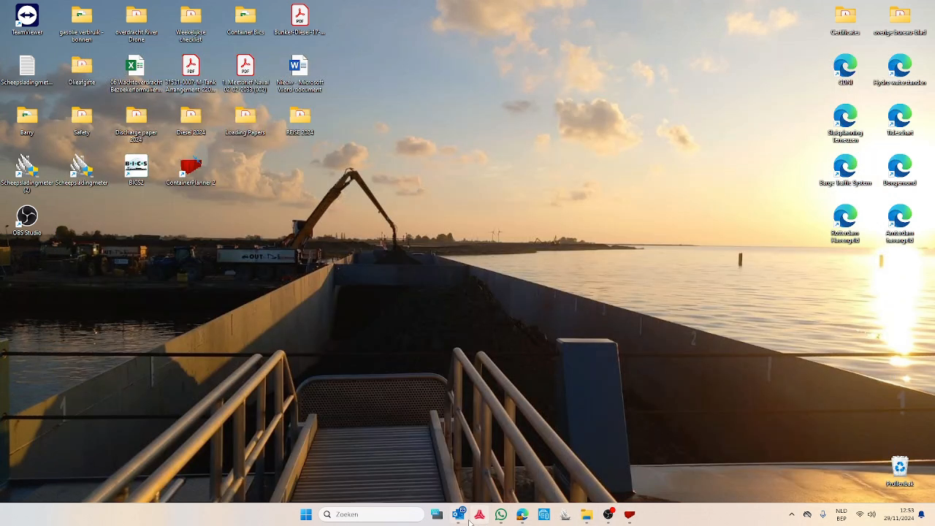
1. Open outlook
2. Save bics in a documents place it in a
3. folder or create a folder

Slide 3
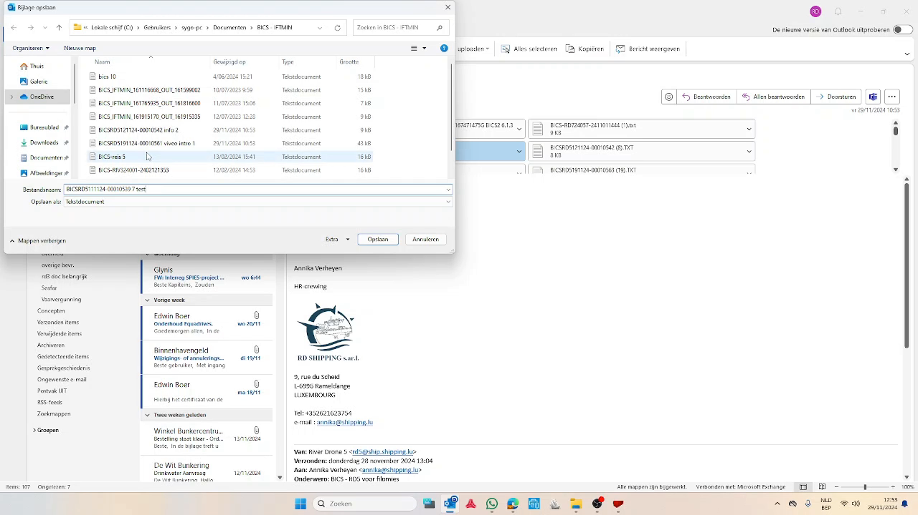
4. Name it to the bicslist
5. don't forget to save!
6. Get out of the mailbox

